Slide 1
This project is a massage shop project.
Reference app https://play.google.com/store/apps/details?id=com.msgtong.matong You can make some additional features based on the app.
1.When the user accesses the app, the app list is displayed in the order of the massage store closest to the user's location.
2. When all users access the app for the first time, the language of the app should appear automatically in Korean language.

Slide 2
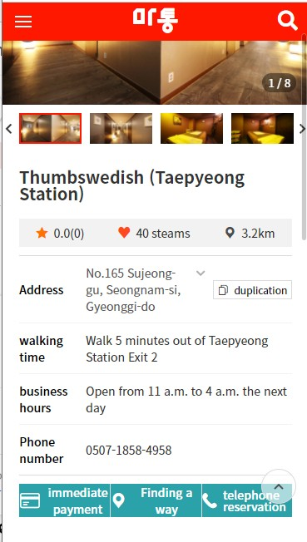
Customers can talk to the massage store by pressing this button.
The important thing is the 050 service phone number provided by Sejong Telecom company in Korea for the privacy of the massage store, so customers can connect to the massage store.
https://www.sejongtelecom.net/pages/service/050_biz
This company provides the 050 phone number api module.

Slide 3
1. Massage store recommendation function..
Anyone who knows the massage store uploads the massage store they want to recommend.
Recommended page sample : https:/m.smartplace.naver.com/places/registration
And when a customer writes a massage store on the recommendation page and uploads the massage store they want to recommend, the manager checks the uploaded information in the manager panel.
And the manager can give points to the person who recommends the massage store.

Slide 4
2. Massage store information upload function
Massage store owner in our app The massage store owner has the
ability to upload the massage store he or she runs in our app.
When the massage store owner uploads his/her own store to our app,
the manager reviews and approves the uploaded store in the manager
panel, the massage store will be exposed in our app.
Sample store registration (upload) page:
https://smartplace.naver.com/businesses/new?step=basic

Slide 5
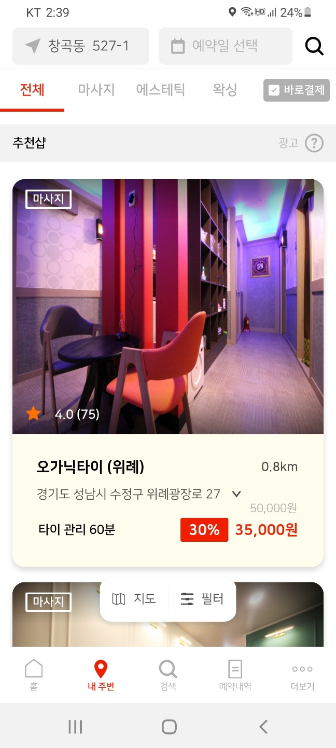
Create a reservation button
When you click the Reservation button, this reservation pop-up will appear.
Area
Type
Number of people
Time
3.Easy reservation function
Users can make simple reservation requests in the app
When a user requests a simple reservation from the massage store in the app,
The massage store owner who received the request sends a push notification to the user with the available reservation time and massage store information
The user then receives a push notification from the massage store owner, allowing them to make a reservation

Slide 6
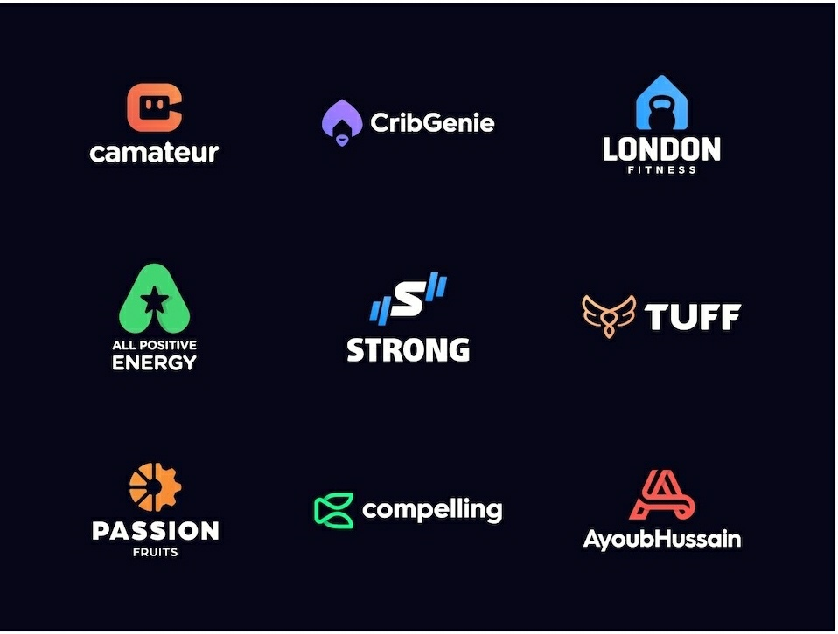
The logo name is Live Spot
Below is a sample logo, you can choose and make it

